Slide 1

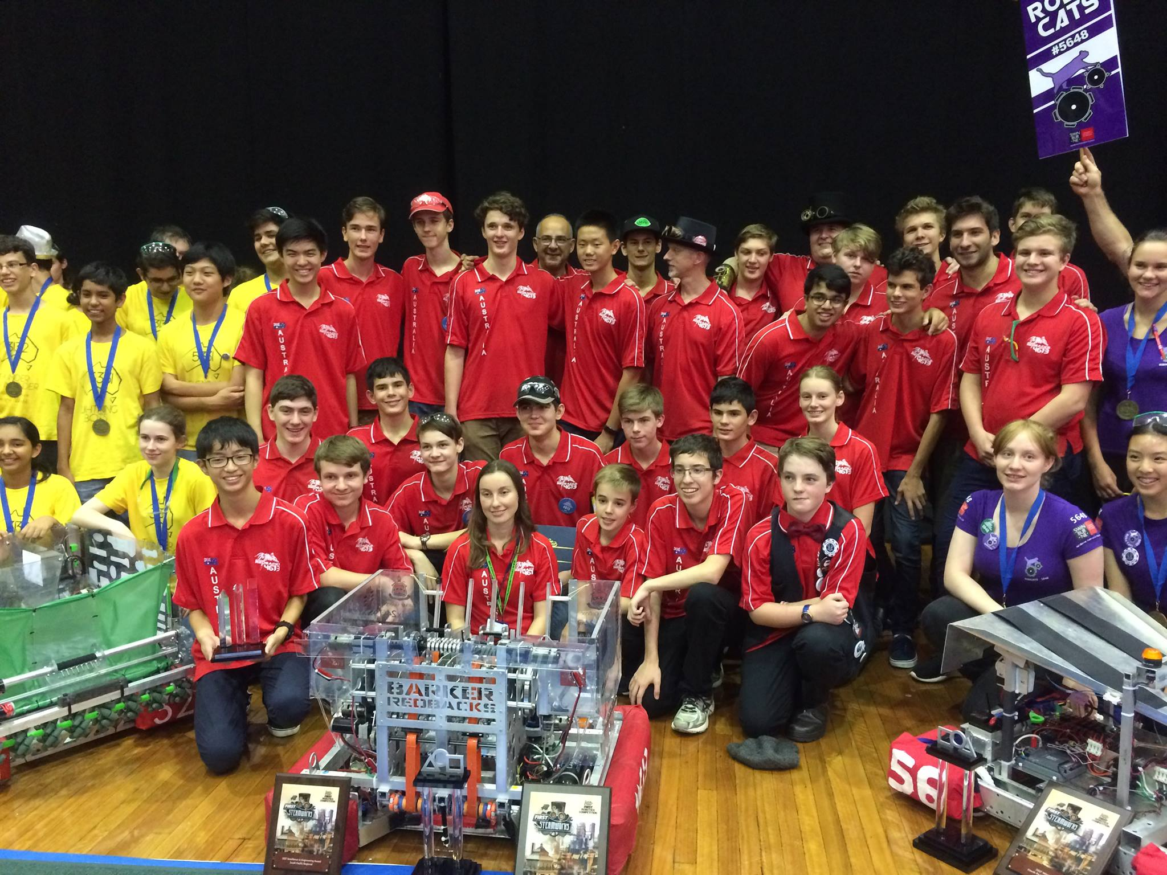
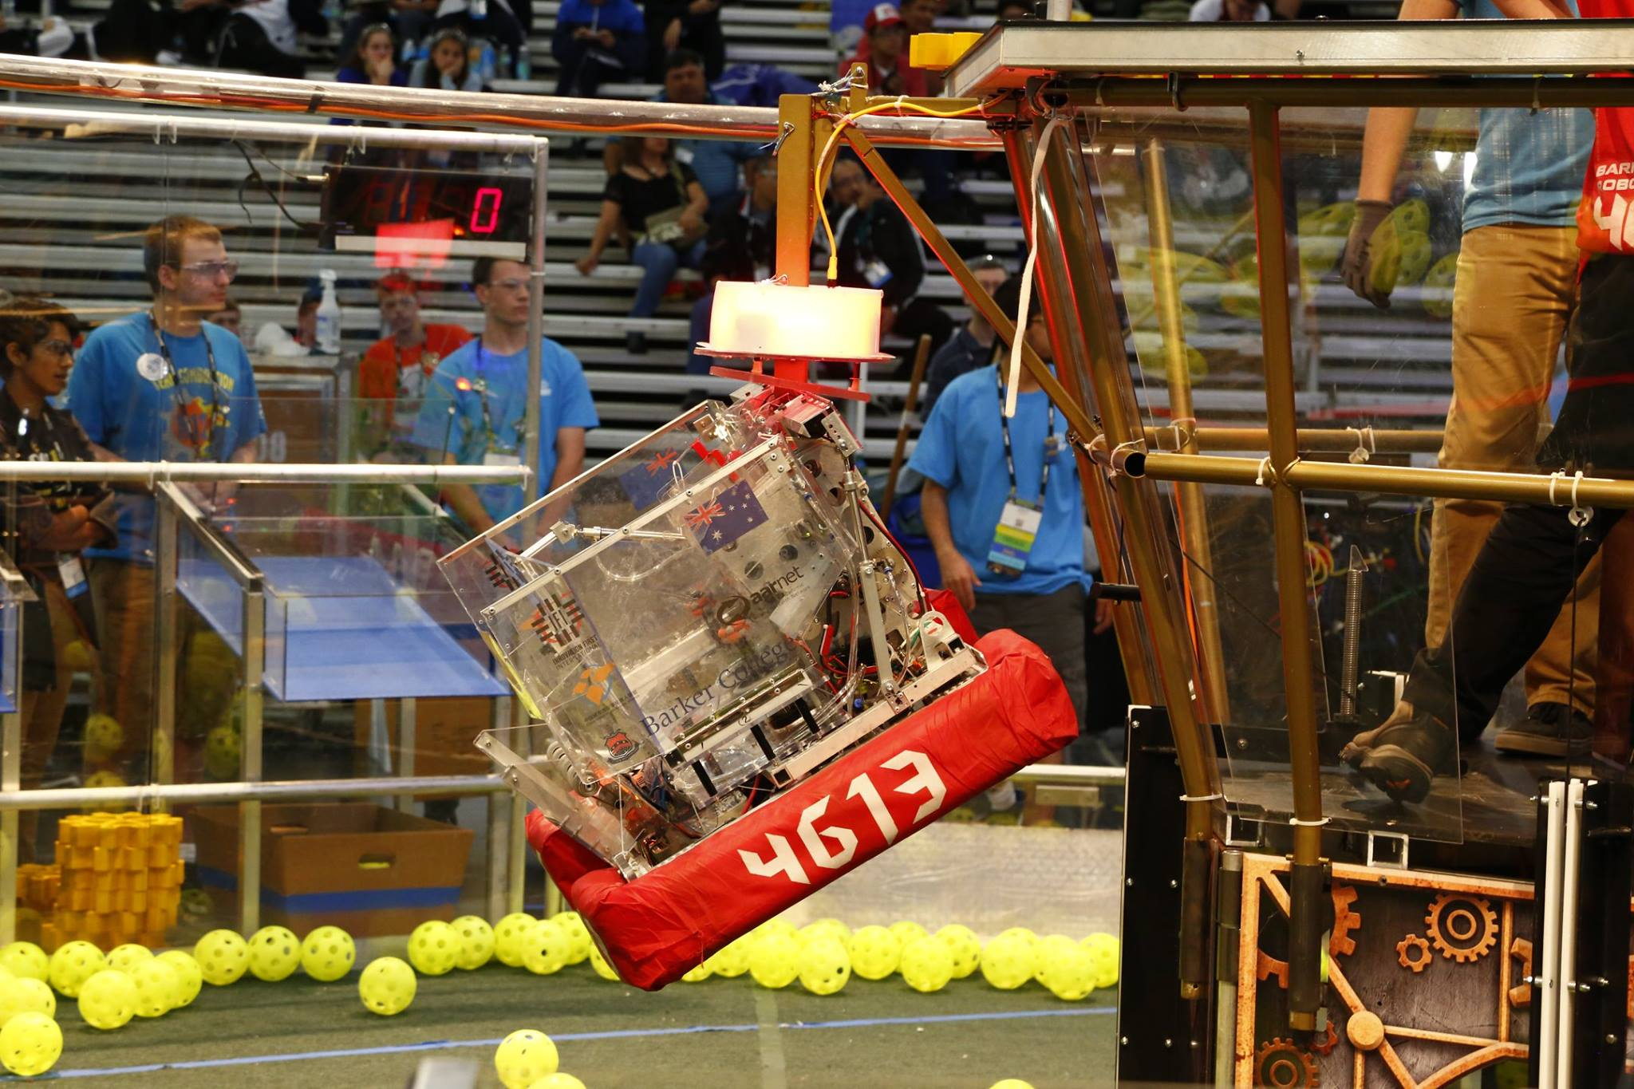
Introduction to (Java) Programming – 2.1 - Output
Tom Schwarz

Slide 2
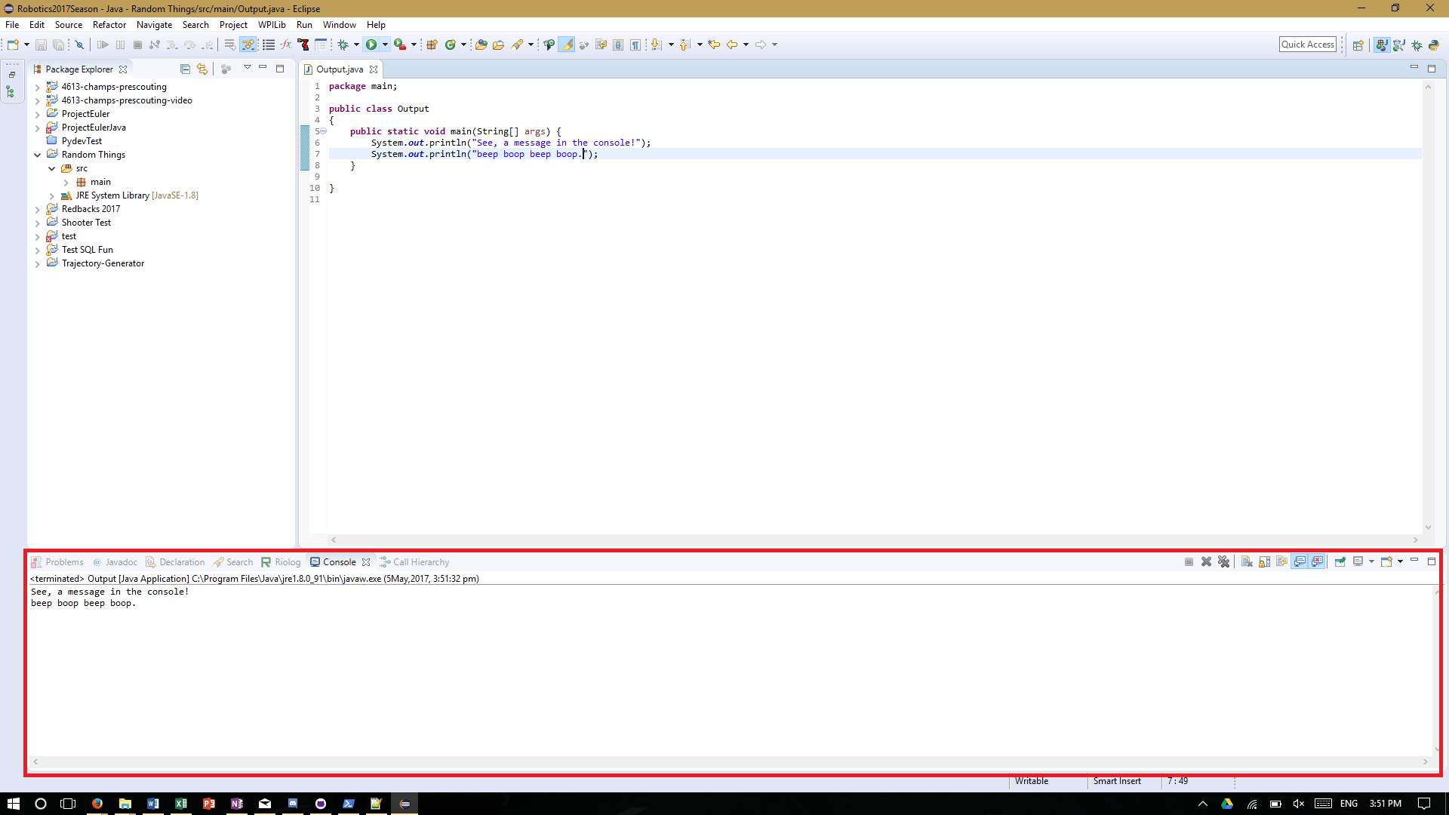
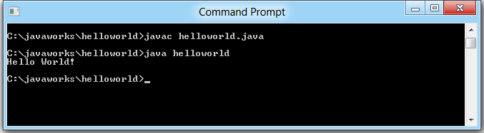
Lesson 2: Output!
Ability to output data is very important
Without being able to output, computers would be essentially useless
A common way to output data is to the console, which is a text stream where you can write text to.

Slide 3
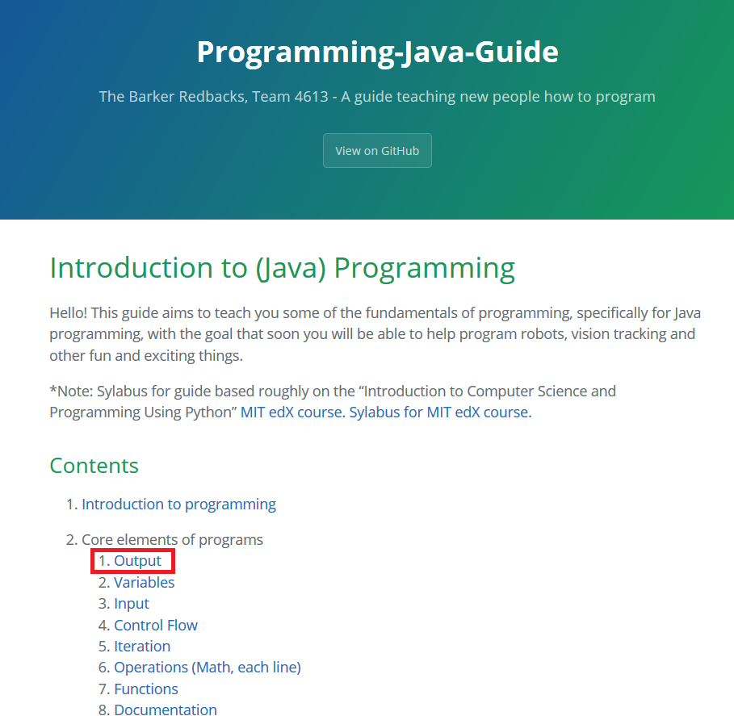
Lesson 2: Output!
In this lesson you will:
Create a new Java project, and start a program
Write a simple program to output some text
So now, if you go the 2nd lesson, 2.1. Output, it will step you through what you need to do
Website is https://team4613-barkerredbacks.github.io/Programming-Java-Guide/

